Slide 1

Handwritten CAPTCHA for Authentication
Batch No: B-02 Project Guide:
M.Uma Maheswari (164G1A05B4) Mr. Lingam Suman _{MTech}
H.Sai Lavanya (164G1A0587) Assistant Professor`
C.Pavani (164G1A0565)
C.Vamsi Krishna (164G1A05B6)
Srinivasa Ramanujan Institute of Technology
Department of Computer Science & Engineering

Slide 2
Abstract
Turing test is a process of determining the involvement of robot in attacking the web security services .
This test is commonly useful for web based application in the form of CAPTCHA (Completely Automated Public Turing Test to tell Computer and Human Apart) to prevent from unwanted activities, automated access and the harms caused by the bots.
A CAPTCHA should be as easier as human can solve within few seconds that would be almost impossible to solve by robot.

Slide 3
During the survey, it has been observed that every form submission websites have different forms of CAPTCHA to secure the server but the techniques proposed so far are lacking security.
The motive of this proposed CAPTCHA is to review the existing CAPTCHA techniques in the field of web security services and provide best level of security that is very difficult to be cracked and able to replace the existing systems.
The level of complexity which has been merged in the proposed CAPTCHA may let the human to solve it but it becomes quite difficult to robot.

Slide 4
Requirements
Hardware Requirements:
i3 Processor
Operating System: Windows 7 and above
Software Requirements:
Python IDE
Jupyter

Slide 5
Existing System
During the survey, it has been observed that every form submission websites have different forms of CAPTCHA to secure the server but the techniques proposed so far are lacking security.
Some types of CAPTCHA are often simple to recognize but they get cracked by intruders.
Some others types of CAPTCHA are much difficult to solve by the human.

Slide 6
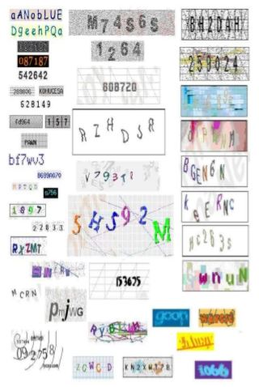

Slide 7
Proposed System
We present the application which focuses on preventing bots from automatically submitting forms with SPAM or other unwanted content.
Our goal is to introduce "Handwritten CAPTCHA" as an automated Turing test that is designed to allow humans to pass with little effort but where the bots fail.

Slide 8
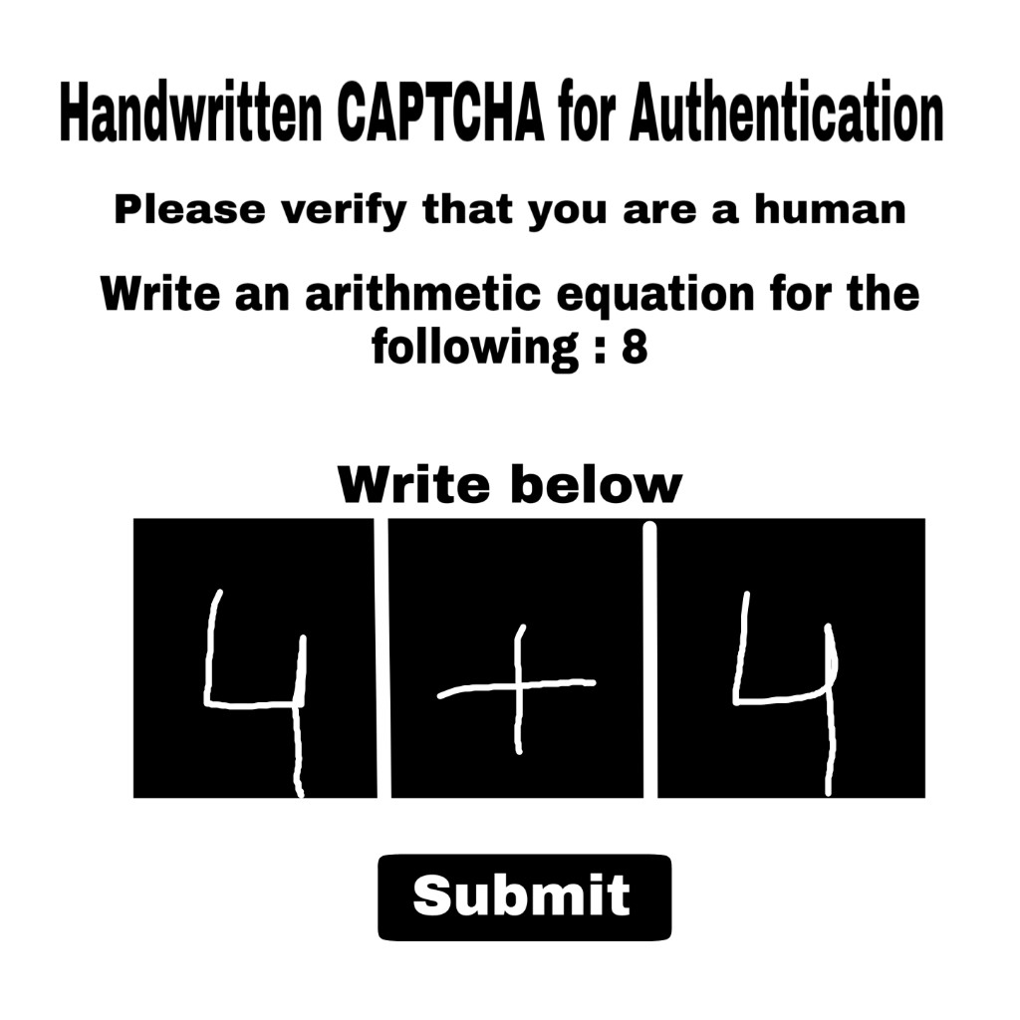

Slide 9
Problem Definition
CAPTCHA-Completely Automated Public Turing test to tell Computers and Humans Apart is a test that can distinguish human users from computer/robot.
We are developing the most secure CAPTCHA for authentication purpose that is very difficult to crack by the intruders.

Slide 10
Planning
Time Schedule
Week 1 : Collecting and working with Dataset.
Week 2 : Designing the web page.
Week 3 : Training, generating the model and testing
(For recognizing the digits and operators).
Week 4 : Integrating web page with generated
machine learning model for solving
CAPTCHA.
Week 5 : Verification and Documentation.

Slide 11
Literature Survey
Base Paper :
Title : CAPTCHA Breaking with Deep
Learning.
Authors : Nathan Zhao, Yi Liu, Yijun Jiang.
Published on : September 2017

Slide 12
References
Shea, Michael (19 November 2015). "CAPTCHA: Spambots, eBooks and the Turing Test". The Skinny. Retrieved 9 January 2016.
Haider A.Alwzwazy, Hayder M. Albehadili, Younes S.Alwan ,Naz E Islam paper on “Handwritten Digit Recognition Using Convolutional Neural Networks” Vol 4 ,Issue 2,February 2016.
http://yann.lecun.com/exdb/mnist/

Slide 13
Review 1 Challenges
Change the Title of the Project.
Application of the Project.

Slide 14
Thank you
Queries
?

